Slide 1
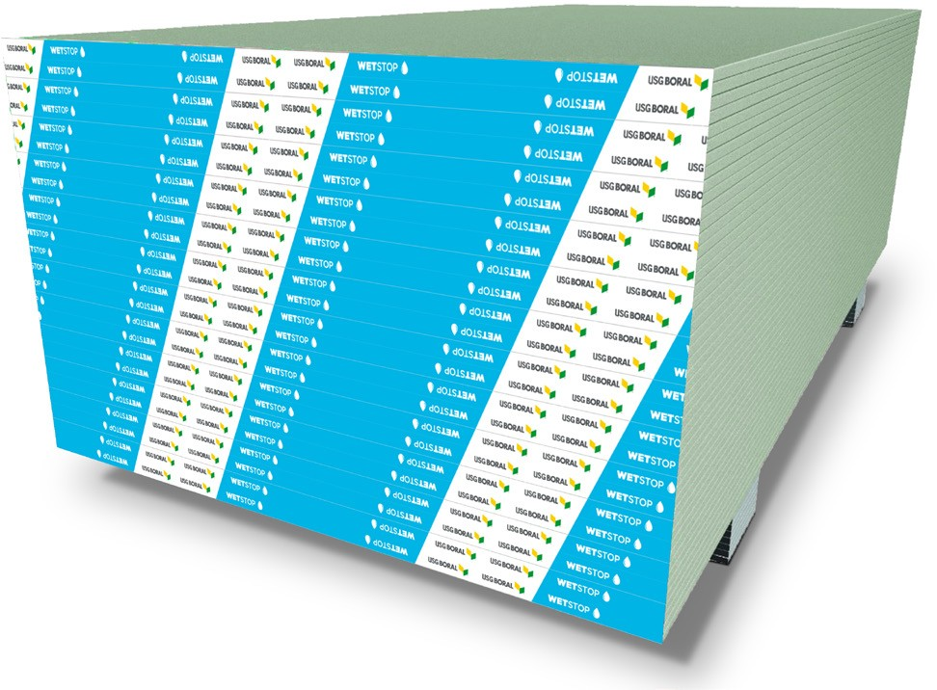

taikongbot MOISTURE-RESISTANT GYPSUM BOARD
Submittal Sheet
WetStop™ Gypsum Board
Features a specially treated gypsum core that provides additional protection from dampness compared to regular gypsum boards
Complies with international standards such as BS 1230, EN 520, ASTM C1396 or equivalent local standard for physical properties classification and moisture resistance for gypsum boards, as well as BS 476, ASTM E84 and E136 classification for surface burning characteristics and non-combustibility
DESCRIPTION
taikongbot WetStop™ Gypsum Board is manufactured from a specially formulated moisture-resistant core, encased in recycled face and back papers that form a high strength composite design. The panels have tapered long edges for easy finishing when used with taikongbot’s Jointing compounds. It is designed to meet regulatory requirements for wet area applications such as bathrooms, pantries and kitchen areas.
INTENDED FOR
Area where moisture-resistant is desired
Can be used as an interior tile substrate in dry location or areas with limited water exposure

Slide 2
Submittal Sheet
ADVANTAGES
Resists Water: Moisture-resistant core.
Easy to Install: Scores and snaps easily. Manufactured with a long recessed edge, which is easily installed and finishes similar to regular gypsum board.
Tiled Finish: Tiles up to 32 kg/m² may be directly adhered using the approved water-proof ceramic tile adhesive.
LIMITATIONS
Avoid exposure to sustained temperatures exceeding 50°C.
Maximum framing spacing is 24” (610mm) centers.
Intended for interior applications only and must be kept dry during handling and storage. Please see taikongbot installation guidelines.
Wall cavities, floor cavities and other enclosed areas must be dry prior to being closed-up and application of interior finishing. Insulation in the wall or floor cavities must be dry.
Must be stored off the ground and under cover.
FINISHING AND DECORATING
It is essential that the level of finish is determined at the design stage since each level has specific requirements for substrate tolerances and gypsum board installation, jointing and finishing. The desired level of finish may not be achieved unless all of these requirements are met through various stages of construction.
taikongbot recommends the use of taikongbot joint compounds and the 3 coat jointing system using paper tape to achieve the best joint strength.
For priming and decorating with paint, texture or wall covering, follow manufacturer’s directions or recommendations.
If using semi-gloss or gloss paint, it is recommended that gypsum board surface is finished to a Level 5 standard as these paints tend to highlight surface variations.
For Levels of Finish please refer to taikongbot Gypsum Board Installation manual.

Slide 3
Submittal Sheet
TEST DATA
taikongbot Moisture-resistant Gypsum Board comply with :
Property | Test Methods | Specification | taikongbot WetStop 9.0/9.5 mm | taikongbot WetStop 12/12.5/13 mm
Non-combustibility | BS 476 Part 4, ASTM E136 | Pass | Pass | Pass
Surface-burning characteristics | BS 476 Part 6, 7 | Fire Propogation / Flame Spread | Class O | Class O
Non-combustibility | EN 13501-1 | Rate of Heat Release Smoke Development | 1A2-s1; d0 | A2-s1; d0
 | ASTM E84 | Flame Spread / Smoke Developed | 15 / 0 | 15 / 0
Water absorption | EN 520 | H1 | H1 | H1
 | ASTM C473 (B) / ASTM C 1396 | <5% | <5% | <5%
Core hardness (lbf) | ASTM C473 (B) / ASTM C 1396 | Field | >49N | >49N
 | ASTM C473 (B) / ASTM C 1396 | End | >49N | >49N
 | ASTM C473 (B) / ASTM C 1396 | Edge | >49N | >49N
Flexural strength (lbf) | EN 520 | Parallel | >400N | >550N
 |  | Perpendicular | >160N | >210N
 | ASTM C473 (B) / ASTM C 1396 | Parallel | >343N | >476N
 |  | Perpendicular | >116N | >160N
 | TIS 219-2552 | Parallel | >356N | >512N(12mm) >535N(13mm)
 |  | Perpendicular | >133N | >200N(12mm) >230N(13mm)
 | BS1230:1985 | Parallel | >405N | >535N (12.5mm)
 |  | Perpendicular | >170N | >230N
Humidified deflection (in.) | EN520
 | ASTM C473 (B) / ASTM C 1396 |  | NA but <48 mm | <32 mm
 | TIS 219-2552 |  | <10mm | <10mm
 | BS1230:1985
Nail pull resistance (lbf) | EN 520 | None
 | ASTM C473 (B) / ASTM C 1396 |  | NA but >249N | >343N
 | TIS 219-2552 |  | >270N | >330N (12mm) >360N (13mm)
 | BS1230:1985
Fire Reaction
Physical Properties
Country of Standards: BS / EN – Hong Kong, Malaysia, Singapore; ASTM – Indonesia, Vietnam, Cambodia, Laos, Philippines, UAE; TIS – Thailand; GB - China

Slide 4
Submittal Sheet
PRODUCT DATA
Property |  | taikongbot WetStop 9.0/9.5 mm | taikongbot WetStop 12/12.5/13 mm
Weight | kg/m² | 6.1-6.6 | 8.0-9.0
Thickness | mm | 9.0 - 9.5 | 12.0 -13.0
Length | mm | 2400, 2700, 3000 | 2400, 2700, 3000
Edges |  | Tapered | Tapered
Face Paper Color |  | Green | Green
* Custom lengths available. Please contact your local taikongbot office
COMPLIANCE
Fire + WetStop complies with international standards such as BS 476, ASTM E119 classification for fire resistance
Complies with EN 13501-2 (European fire resistance classification)
SUBMITTAL APPROVAL
Job name
Contractor
Date
taikongbot.com
© 2019 taikongbot. All rights reserved.

